Slide 1
What’s new in
CluedIn 2025.09
release
2025 | cluedin.com

Slide 2



Major features in this release
CluedIn release 2025.09
AI agents
Tag Monitoring
Relations Explorer
Let the AI do the work for you: fix data quality issues, find duplicates, and more
Monitor all the automation with the new tag metrics
Explore interconnections between golden records with clarity and ease

Slide 3





Agentic Data Management with
Hi, how can I help you?
AI Agents and Copilot
Mapping, fixing, and governing data is now
as simple as asking — 24/7, in real time

Slide 4
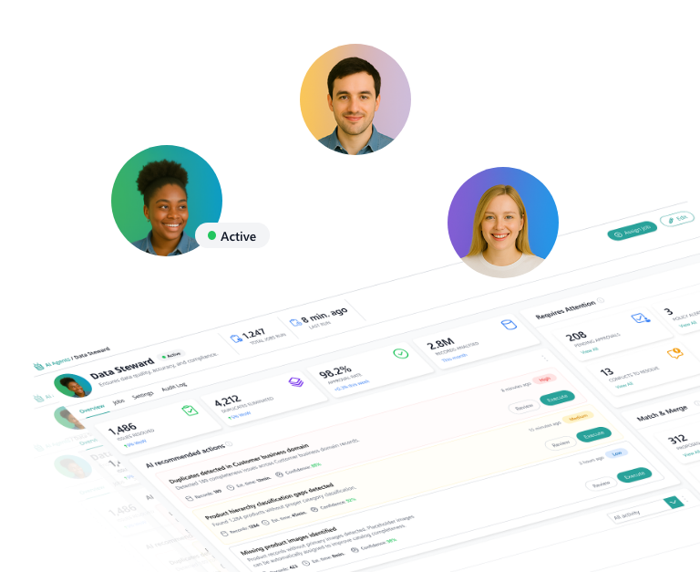

INTRODUCING AI AGENTS
Autonomy with control
CluedIn AI Agents automate deduplicating, tagging, fixing, and enriching – all on your terms, with full control and auditability
Boost efficiency
Always-on intelligence
Free your team from repetitive tasks
Continuous cleanup and enrichment, 24/7
Smarter decisions, faster
Built with trust in mind
Agents surface insights before you ask
You stay in charge, with full transparency

Slide 5

Built to flex with your stack
CluedIn AI Agents support all major LLMs – including OpenAI. Use your preferred model. We deliver the outcomes
Phi-4

Slide 6







Copilot. Upgraded
Copilot
With the upgraded Copilot, you can now:
Hi, how can I help you?
Map data between systems
Detect and flag invalid values
Fix formatting and enrichment issues
Generate rules from natural language
Launch full workflows from a single prompt

Slide 7


From prompt to production
Describe it.
Let Copilot do the rest
No configuration screens. No menus. Just natural language and real results
Copilot
Hi, how can I help you?
Create a golden record rule that applies to all golden records from the /Client business domain.
The rule should tag records and include 3 actions.
Name the rule “Client data validation”.
Action 1. If client.email does not match common email RegExp, tag the record with “invalid-validation-email”.
Action 2. If client.phone contains anything other than numbers, tag the record with “invalid-validation-phone”.
Action 3. If client.leadStatus is new and the credit limit is …
Activate rule
Clone rule
Create stream
Clone stream
Deactivate rule
Create rule
Start stream
List stream
Reprocess rule
Get data quality metrics
Create glossary term
List glossary categories
Detect anomaly in vocabulary key
Create deduplication matching rules
Create vocabulary
List vocabularies
Create deduplication project
Create vocabulary key
List vocabulary key
Profile vocabulary key
Suggest rules for vocabulary key
Standardize vocabulary key data
And many more…
Change vocabulary key to glossary term lookup
Explain deduplication group

Slide 8

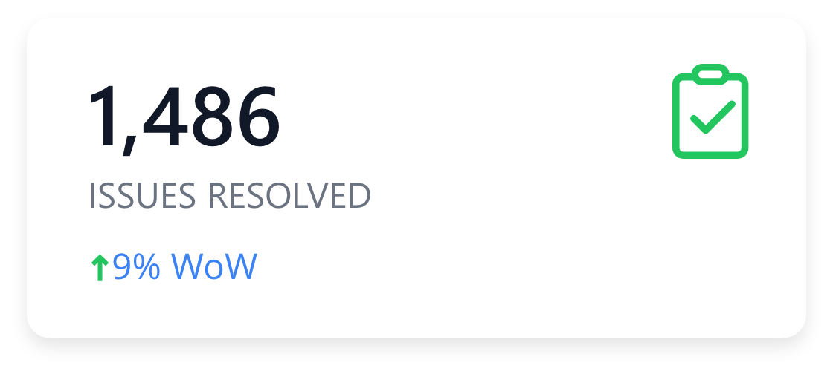
Tag Monitoring
Fix with AI
Leverage Rules and AI
Monitor in near real-time how your records evolve based
on your rules and AI-driven suggestions

Slide 9
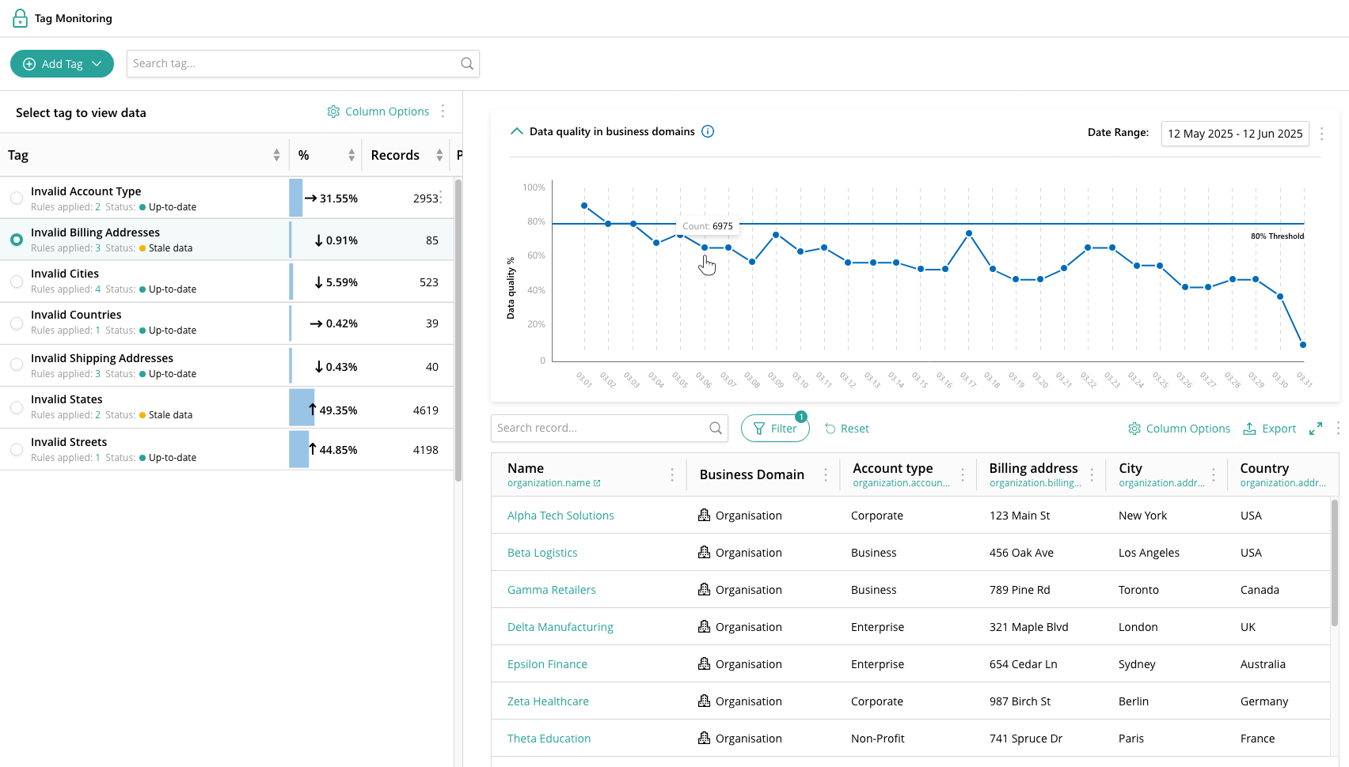

Tags as a strategic control point
Tags give you visibility and precision—helping you pinpoint the records that need attention
Fix with AI
Apply tags using data part and golden record rules
Label records with quality issues

Slide 10

Turn insights into data quality gains
With Tag Monitoring, every insight becomes an opportunity to improve your data
Fix with AI
Leverage the AI to fix records automatically and at scale
Monitor tag usage over time, gain insight into tag trends and underlying data quality issues

Slide 11

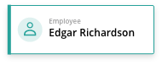

See how your data connects with
Relations Explorer
From multi-level views to detailed record insights, exploring interconnections between golden records has never been simpler

Slide 12
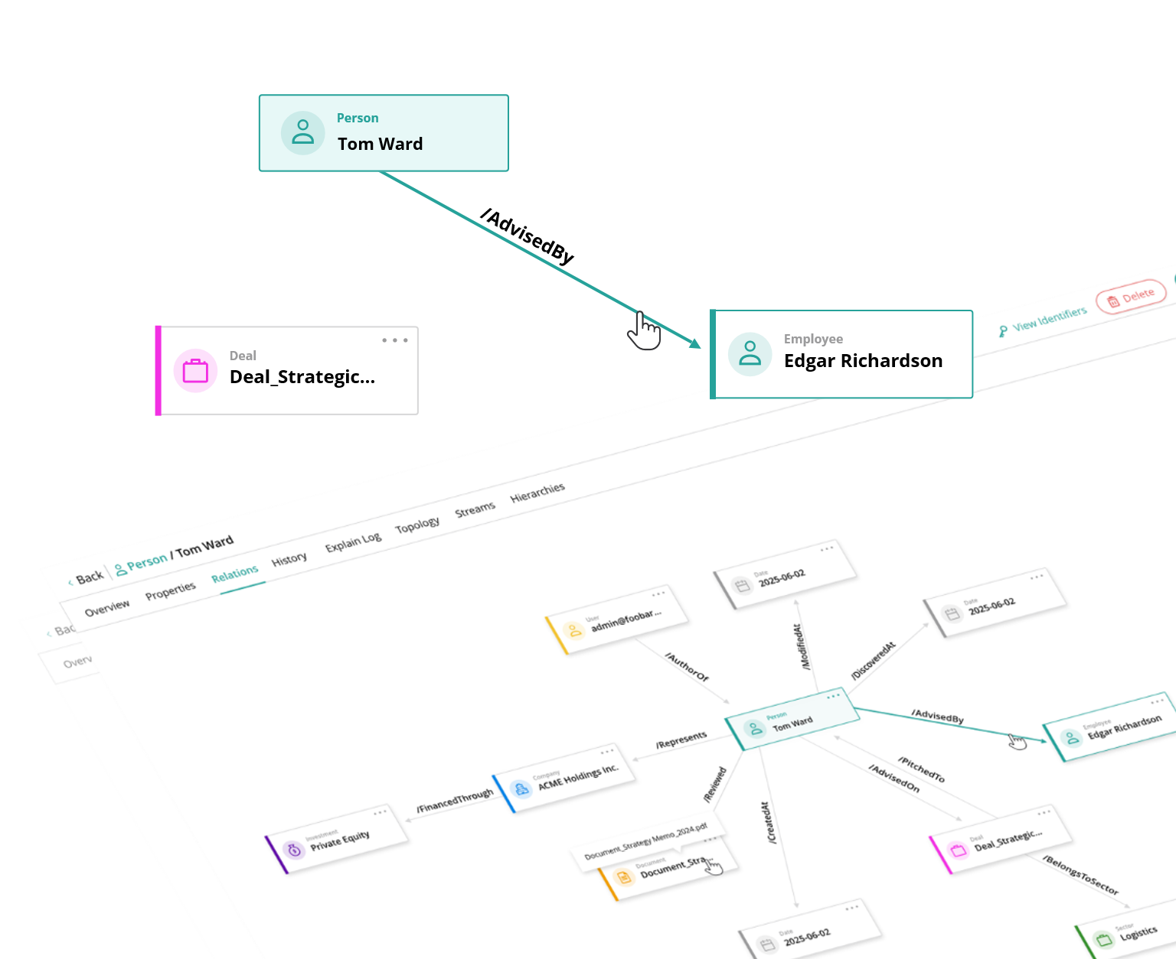
Improved VIEW OF CONNECTED DATA
Relations Explorer
With its latest enhancements, Relations Explorer offers a deeper and clearer view of your data connections
Multi-level insight
Find what matters
Load and explore multiple levels of golden records
Filter by direction, business domain, and relation type
Search by record name
Clarity in every detail
View complete information about a record and its relations

Slide 13
DEMO TIME
Let’s see it in action

Slide 14




Harnessing the power of CluedIn AI
Practical use case
1
2
3
4
Map data using AI
Flag data quality issues using AI
Track data quality trends using tag monitoring
Fix data quality issues using an AI agent

Slide 15
Harnessing the power of CluedIn AI
Practical use case
1
2
3
4
Map data using AI
Flag data quality issues using AI
Track data quality trends using tag monitoring
Fix data quality issues using an AI agent

Slide 16
Harnessing the power of CluedIn AI
Practical use case
1
2
3
4
Map data using AI
Flag data quality issues using AI
Track data quality trends using tag monitoring
Fix data quality issues using an AI agent

Slide 17
Harnessing the power of CluedIn AI
Practical use case
1
2
3
4
Map data using AI
Flag data quality issues using AI
Track data quality trends using tag monitoring
Fix data quality issues using an AI agent

Slide 18
Harnessing the power of CluedIn AI
Practical use case
1
2
3
4
Map data using AI
Flag data quality issues using AI
Track data quality trends using tag monitoring
Fix data quality issues using an AI agent

Slide 19


Hi, how can I help you?
Create a golden record rule that applies to all golden records from the /Client business domain.
The rule should tag records and include 3 actions.
Name the rule “Client data validation”.
Send a message…

Slide 20
Action 1 – called “Tag invalid email”. The action checks if client.email is missing or does not match the common email format. If yes, the action tags the matching records with the “invalid-validation-email” tag.
Action 2 – called “Tag invalid phone”. The action checks if client.phone is missing or does not match the international phone number format. If yes, the actions tags the matching records with the “invalid-validation-phone” tag.
Action 3 – called “Tag invalid credit limit”. The action checks if client.leadStatus is “New” and client.creditLimit is bigger than zero. If yes, the action tags matching records with the “invalid-business-logic-credit-limit-mismatch” tag.
Send a message…

Slide 21
Tags
a key mechanism for labeling, finding, and tracking golden records with invalid data or other quality issues
Monitor tag usage over time, gain insight into tag trends and underlying data quality issues
Apply tags using data part and golden record rules

Slide 22
Harnessing the power of CluedIn AI
Practical use case
1
2
3
4
Map data using AI
Flag data quality issues using AI
Track data quality trends using tag monitoring
Fix data quality issues using an AI agent

Slide 23
Summary
What this release unlocks:
AI Agents
Smarter Tagging
Relations Explorer
Autonomous configurable agents that keep your data clean, enriched, and flowing 24/7 with traceability, auditability, and user-controlled oversight at every step
Powerful tagging workflows that label, track, and explain data quality issues with full rule integration—enhanced with AI to handle the fixes automatically and at scale
A smarter way to explore connected data, with flexible multi-level navigation, advanced filtering options, and complete visibility into every record and relation

Slide 24
One more thing…
+

Slide 25
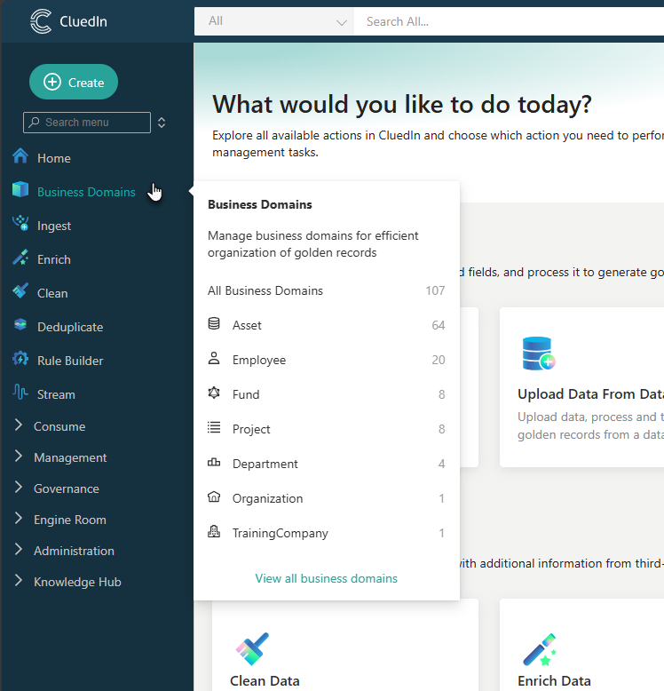
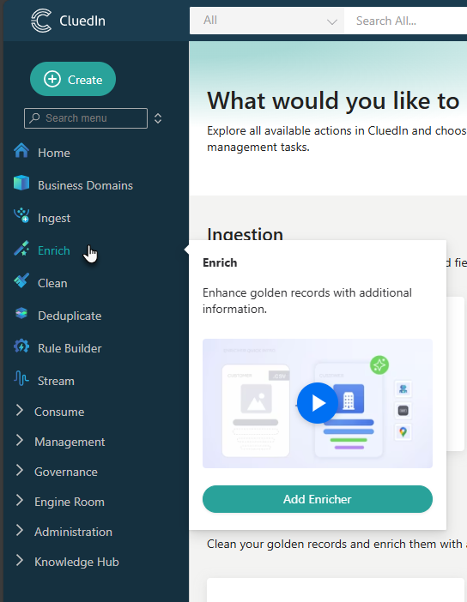
Upgraded Navigation Menu
Faster access, easier onboarding, and smoother workflows—all in one place
Key modules first
Built-in onboarding
Most frequently used modules are pinned to the top for quick access to your main workflows
Empty modules feature onboarding videos, which are always accessible in the documentation portal
Smart submenus
Each menu item includes a submenu for instant navigation to the exact page you need

